Slide 1
Corridor Group – ETL Discussion

Slide 2
What is ETL?
ETL stands for Extract, Transform, Load
It’s a common term referring to the process of pulling data from one system (Extract), manipulating the data for what is needed (Transform), and transferring to another system (Load).

Slide 3
HIM Teams and ETL
HIM Teams’ processes have always been based on ETL:
Extract | Transform | Load
Run report from source EMR system. | Filter out charts, look up product rates, etc. inside a spreadsheet. | Key the resulting charts into HHCP.

Slide 4
HIM Teams and ETL
Recently, conversion worksheets and HHCP upload wizards were added to aid in the process:
 | Extract | Transform | Load
Original Process | Run report from source EMR system. | Filter out charts, look up product rates, etc. inside a spreadsheet. | Key the resulting charts into HHCP.
Improved Process | Run report from source EMR system. | Paste into conversion worksheet. Get transformed data from tab. | Load the transformed data using the data import wizard in Salesforce/HHCP.
Typically, both of these processes are referred to as “manual processes” because they still require someone to complete the work.

Slide 5
RPA and SSIS
While the conversion worksheets add a little bit of efficiency, they still require a lot of manual work. Enter two new technologies:
RPA – Robotic Process Automation
RPA is a specialized category of technology that mimics some the actions of a human on a computer. Due to a variety of different EMR systems and inability to integrate with them, RPA is a great tool for Extracting information from these systems.
RPA is often just referred to as “the robot” or “the bot”. RPA is actually a mixture of technologies – You may hear terms such as “UIPath” or “dot NET”. For this conversation, we will stick to the term “RPA”.

Slide 6
RPA and SSIS
SSIS – SQL Server Integration Services
When transforming data, it is often useful to have a database of information that allows for advanced troubleshooting, processing performance, and other advantages. For this task, a Microsoft SQL Server database is used.
SSIS is a mixture of technologies designed to bring existing data (Excel spreadsheets) into a SQL Server database, Transform data using business rules, and Load that data into HHCP.

Slide 7
Ideal Future State
 | Extract | Transform | Load
Original Process | Manual reporting | Transform by hand | Hand key charts
Improved Process | Manual reporting | Conversion Worksheet | Upload wizard
Ideal Process | RPA | SSIS | SSIS
In the ideal future state, RPA will do automated reporting extracts from various source EMR systems and send them to SSIS. SSIS will apply the business rules to reject certain charts, clone others, look up agency and product rate codes for each chart, and automatically send them to HHCP.

Slide 8
Reality
Reality is a little more complicated. For various reasons including focus on high volume customers first, various portions of agency ETL processes have been automated at different steps.
 | Extract | Transform | Load
Intrepid | RPA | RPA/SSIS | SSIS
St. Jo | RPA | Conversion Worksheet | Upload wizard
Kindred - Main | RPA | SSIS | SSIS
Kindred – Greensboro | Manual Pull | SSIS | SSIS
LHC – Most charts | RPA | SSIS | SSIS
LHC – RECERT and ROC exceptions | Manual Pull | SSIS | SSIS
LifeCare | Manual Pull | SSIS | SSIS

Slide 9
SFTP and SCP/WinSCP
In order to securely transmit information from various EMR systems and networks, we use secure file copy technology.
SFTP = The server where sensitive files are stored.
SCP/WinSCP = The secure technology/software we use to copy files to/from the SFTP server.
All HIMs should have WinSCP installed on their computers at this point.
This technology is used by RPA to send files to SSIS. It’s also used by HIMs to send files to SSIS and receive files from RPA.

Slide 10
SCP/SFTP Examples
 | Extract | Transform | Load
St. Jo | RPA | Conversion Worksheet | Upload wizard
For St. Jo, RPA does the file extracts from the EMR system and drops them out on the SFTP server. The assigned HIM team connects and copies those files from the SFTP server to their computers in order to complete the Transform and Load steps manually.
 | Extract | Transform | Load
LifeCare | Manual Pull | SSIS | SSIS
For LifeCare, it’s the opposite. The HIM team manually extracts from the EMR system and copies them out on the SFTP server using WinSCP. SSIS automatically picks up the files from the SFTP server and completes the relevant Transform and Load steps.

Slide 11
SCP/SFTP Examples
 | Extract | Transform | Load
Kindred - Main | RPA | SSIS | SSIS
Kindred – Greensboro | Manual Pull | SSIS | SSIS
For Kindred, most of the charts are extracted and copied to the SFTP server automatically. SSIS then completes the transform and load steps automatically. However, there is a new file extract that RPA isn’t configured to perform yet. In that case the HIM team manually pulls the file, copies it via SFTP, and SSIS picks up the process from there.
LHC has a similar temporary process. It’s important to be aware that HIMs may be tasked with steps in the beginning, middle, or end of the ETL process. Sometimes, these changes are temporary while waiting for changes to be made.

Slide 12
Maintaining the Machine
The Transform step of SSIS is tricky. Chart processing is changing constantly. New locations come aboard, new payor logic, new forms, etc.
In order to handle this, SSIS is looking at various custom objects in HHCP – often referred to as “lookup tables”. Currently, these tables are maintained by Dan Emily and contain the following information:
Agency (locations)
Product Rates for Agencies (by location)
Form to product – When the oasis form field identifies the product
Payor to product – When the payor identifies the product
Agency ETL variables – Identifies which locations are payor dependent among other things

Slide 13
Maintaining the Machine
For HIMs, there are a handful of tasks required to keep these processes in good working order:
Any manual steps outlined by an agency’s ETL process.
Read the error message emails for agencies where you are assigned. Anything with an ERROR should be addressed. If it’s a lookup, odds are that Dan can help correct that in HHCP, though he may have questions about what product a lookup identifies, etc.
When all else fails, Scott Stover is likely to understand the error.
Follow through with the records that have errors. Those records were supposed to make it into HHCP but did not. Any error not handled is a record that is missed. Manual entry of those records is okay if there are a handful. If there are a lot, there are some options to re-run after the error is corrected.
It’s good to review WARNING messages, especially when a client is recently set up to make sure records aren’t getting rejected that should be.

Slide 14
Summary
ETL (Extract, Transform, Load) is a big part of what HIMs do.
RPA (Extract) and SSIS (Transform, Load) are major tools to help automate the work.
Over time, the ideal state is more automation and less manual entry of records.
When rapid changes are required, issues and exceptions found, or automation tools go down, HIMs have to step in and/or revert to manual processes.
Understanding the current processes for agencies your team works on and where in the process you fit will make this far easier to understand.
SFTP (Secure File Server) and WinSCP (Secure copying software) are the tools used to send charts back and forth within these processes.

Slide 15
Questions?

Slide 16
Supplemental Slides

Slide 17
Processing Steps
Load Data To Staging
Find Excel Files
Objective is to store all Agency-submitted raw data in its original state.
Each record is associated to its source file
Each file is archived for future reference and/or reprocessing
Audit and traceability to the source file and Excel row.
Assign Agency Based On Source File Path
Load All Records Staging Table
dbo.agency_file_row

Slide 18
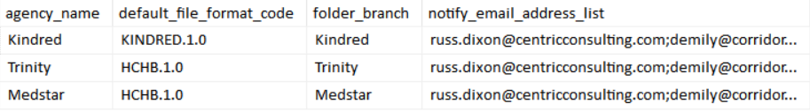
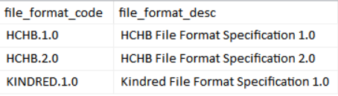
Solution Data
Master table for agencies.
dbo.agency
Master table for file formats.
dbo.file_format

Slide 19
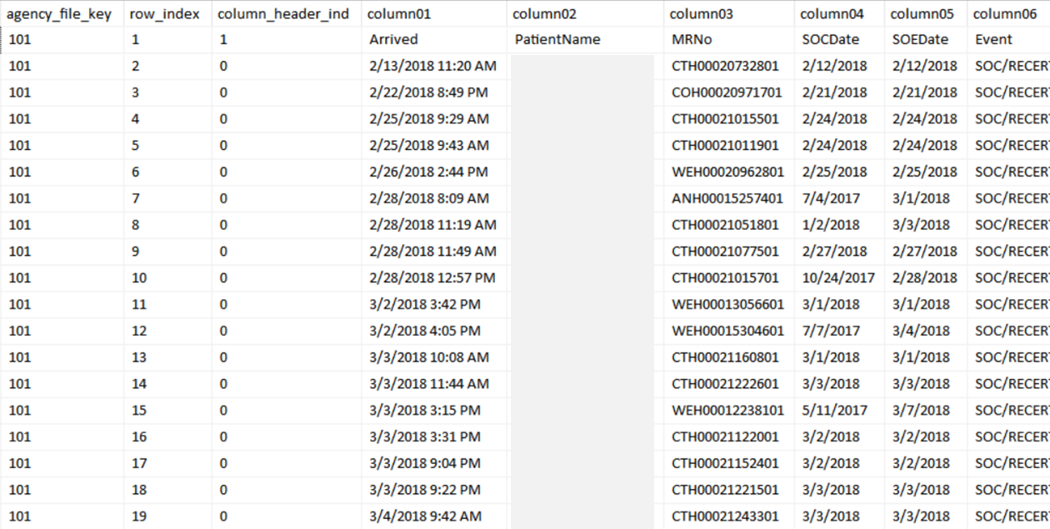
Solution Data
Record of every agency file processed
dbo.agency_file
Staging table for raw agency data
dbo.agency_file_row

Slide 20
Processing Steps
Transform Into Agency Medical Record
Derive Attributes from Staging Column Data
Loads each staging record into the Agency Medical Record
Maintains data integrity of Agency Medical records.
Apply transformations (filtering and text parsing)
Logs staging record transformation errors so they can be addressed.
Apply Attribute Transformations Where Applicable
Load Into Agency Medical Record
dbo.agency_medical_record

Slide 21
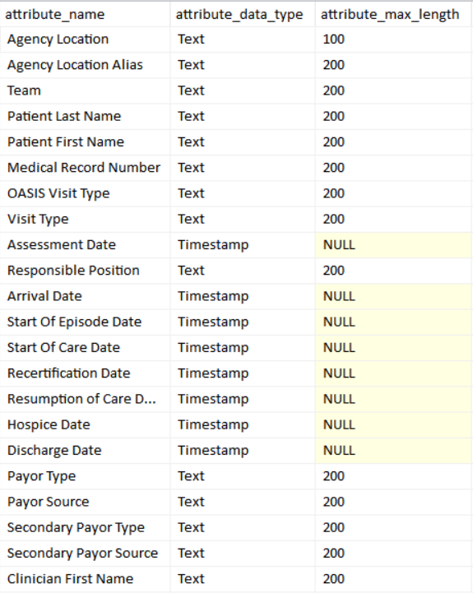
Solution Data
Master table for agency attributes.
dbo.attribute

Slide 22
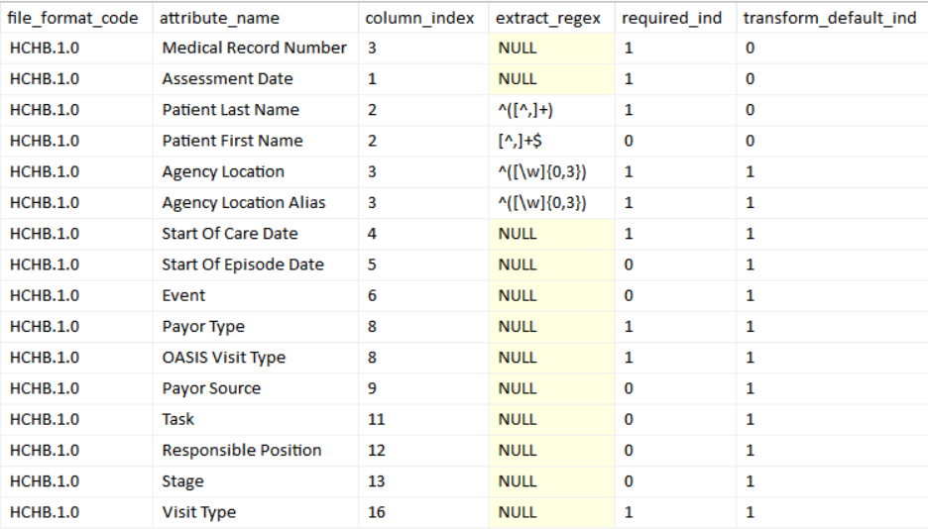
Solution Data
File format attribute transformation rules
dbo.file_format_attribute

Slide 23
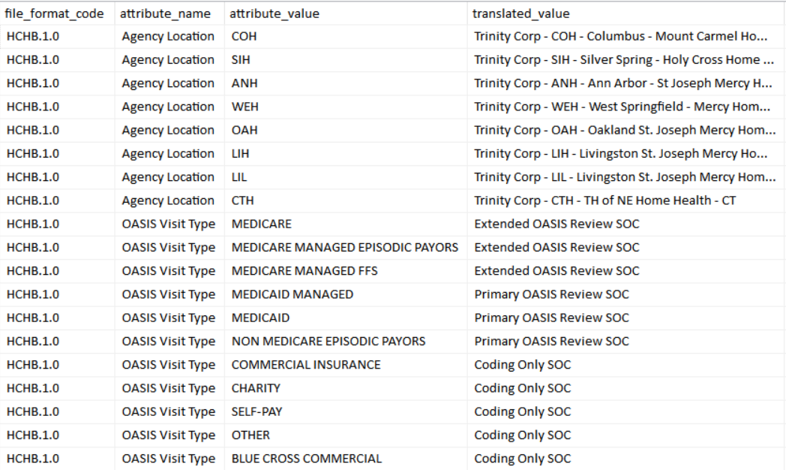
Solution Data
File format attribute value translation rules
dbo.file_format_translate

Slide 24
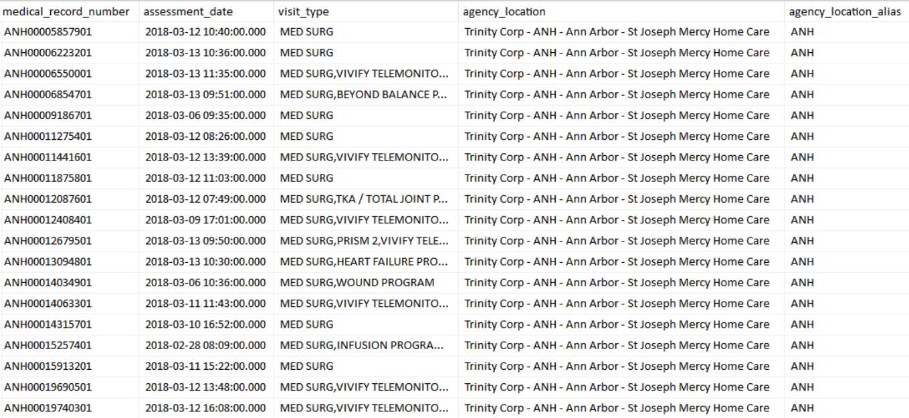
Solution Data
Fully transformed agency medical records
dbo.agency_medical_record

Slide 25
Processing Steps
Sync With SalesForce
Download Reference Data From Sales Force (Periodically)
Periodically pull updated reference data from SalesForce into local tables (daily, weekly?)
Apply filter rules to exclude record from Sync into SalesForce
Upload Agency Medical Record data to SalesForce
Log SalesForce process errors and other scenarios that prevent data uploading.
Filter Agency Medical Records To By Synced
Apply Sync To SalesForce
DM_Submission__c

